Slide 1

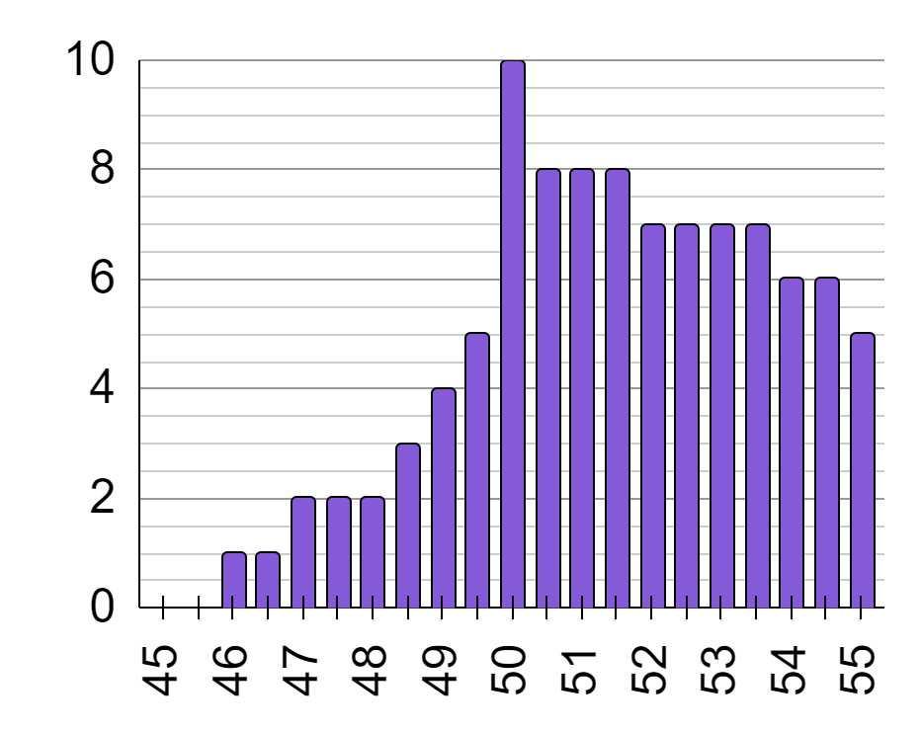
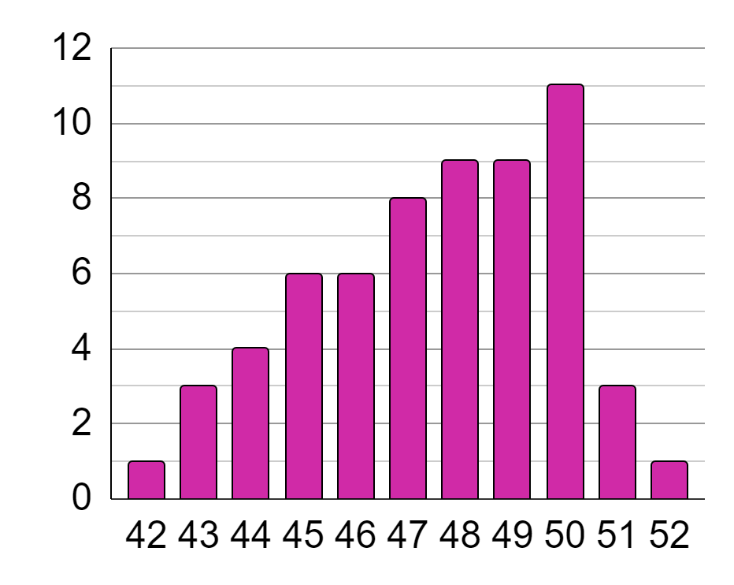
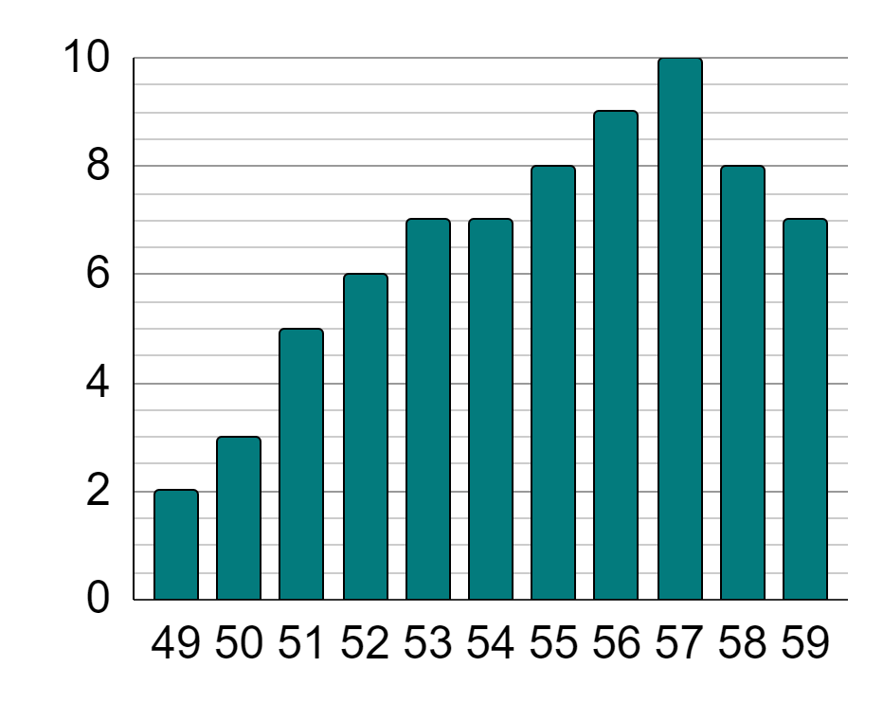
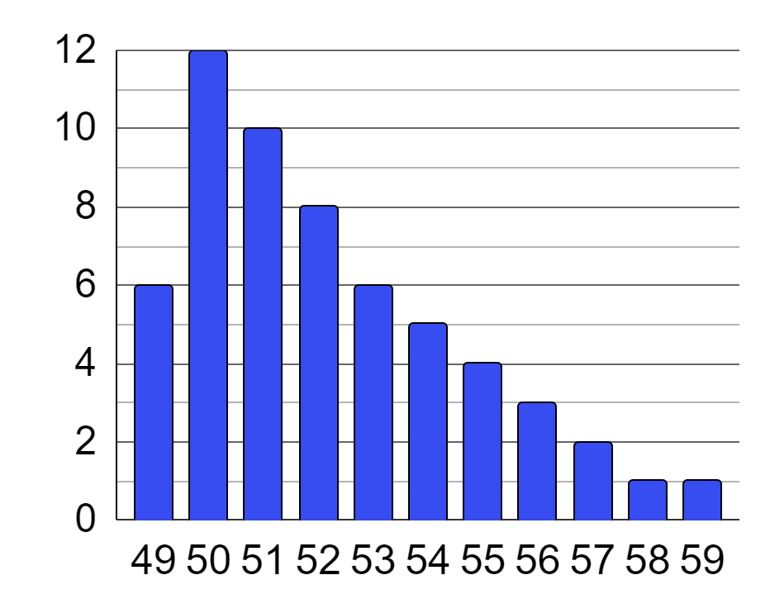
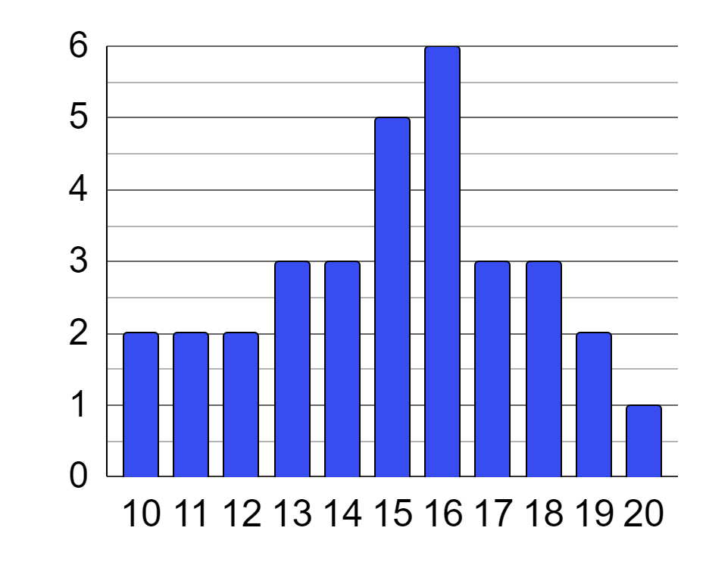
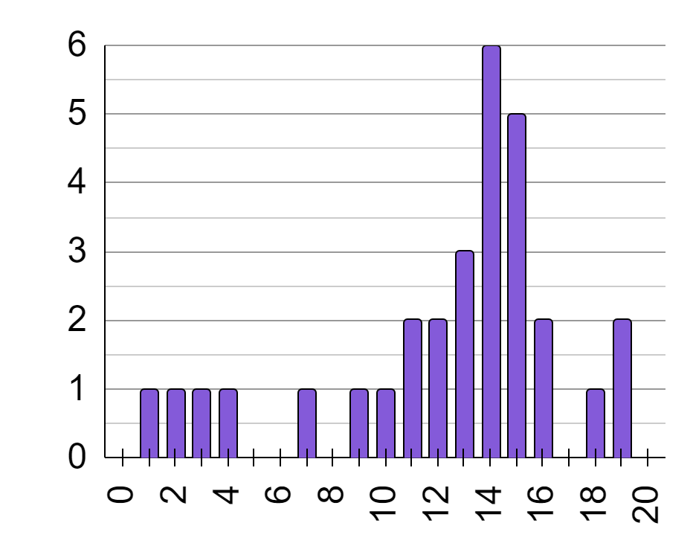
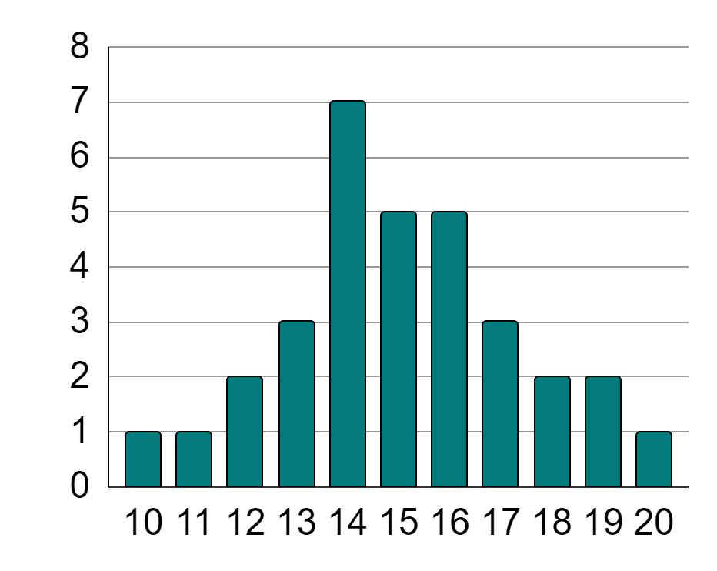
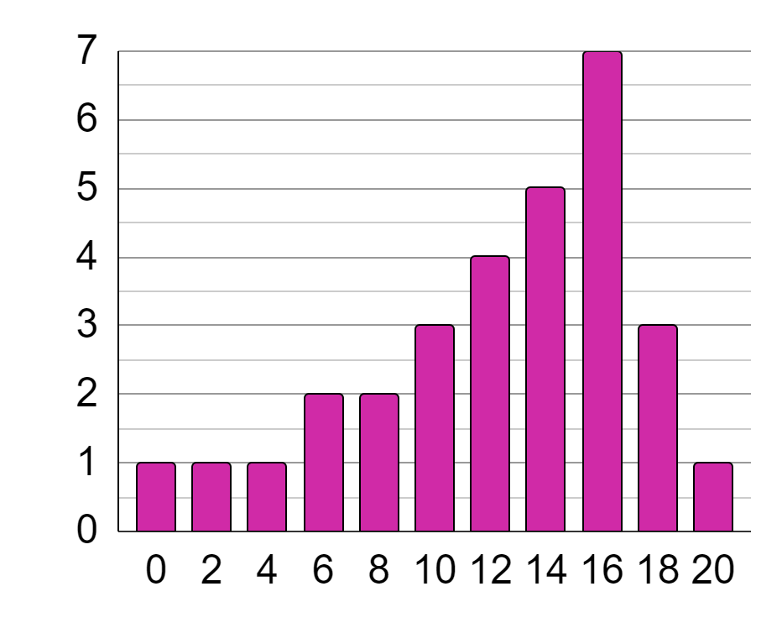
Analysing different statistical representations
Task A: Comparing summary statistics to statistical graphs
1) Which of these summary statistic values is applicable to bar charts a, b, c, d, or any combination of them?
a
b
 |  | a | b | c | d
mean | 55
median | 48
mode | 50
range | 10
c
d
score of class a
score of class b
2) Each summary statistic below matches with a pair of bar charts. For each summary statistic, write down its value and the names of the two classes it represents.
mean | 15 | a
score of class c
score of class d
mean | 12.3 | b
mode | 16
mode |  | c
range

Slide 2
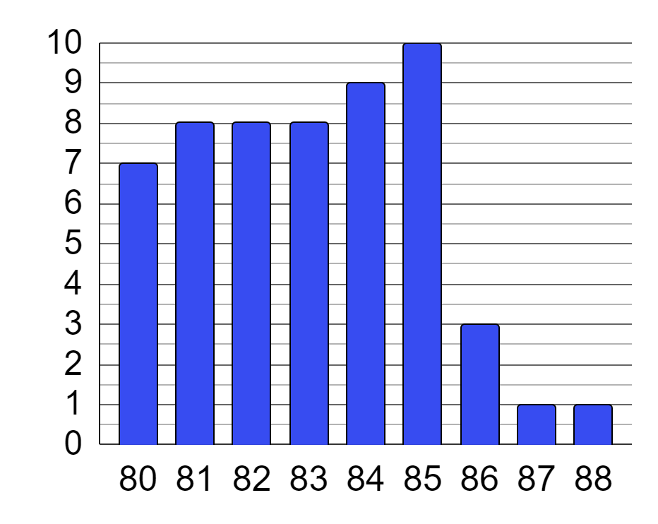
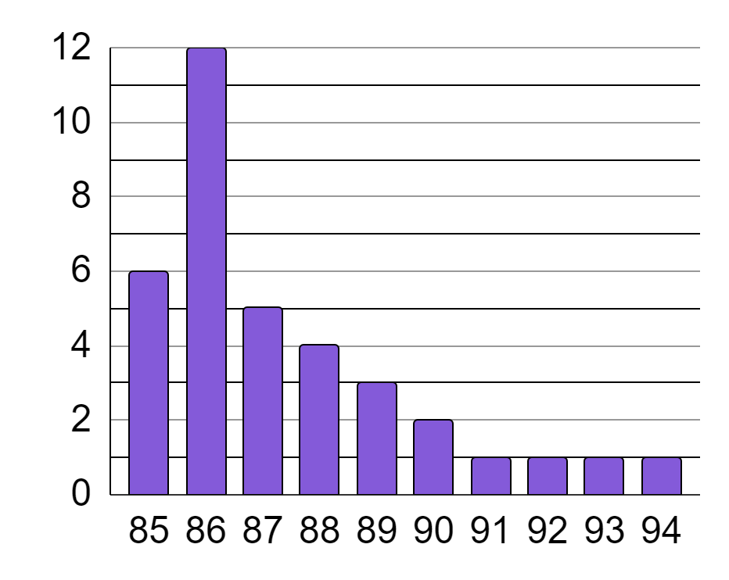
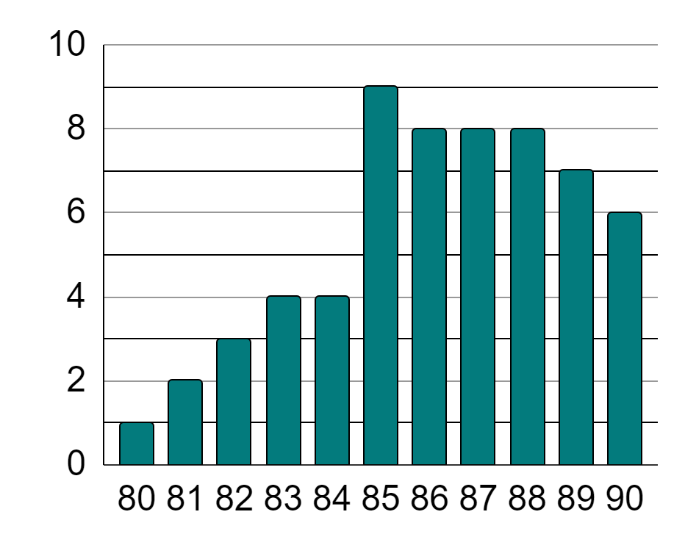
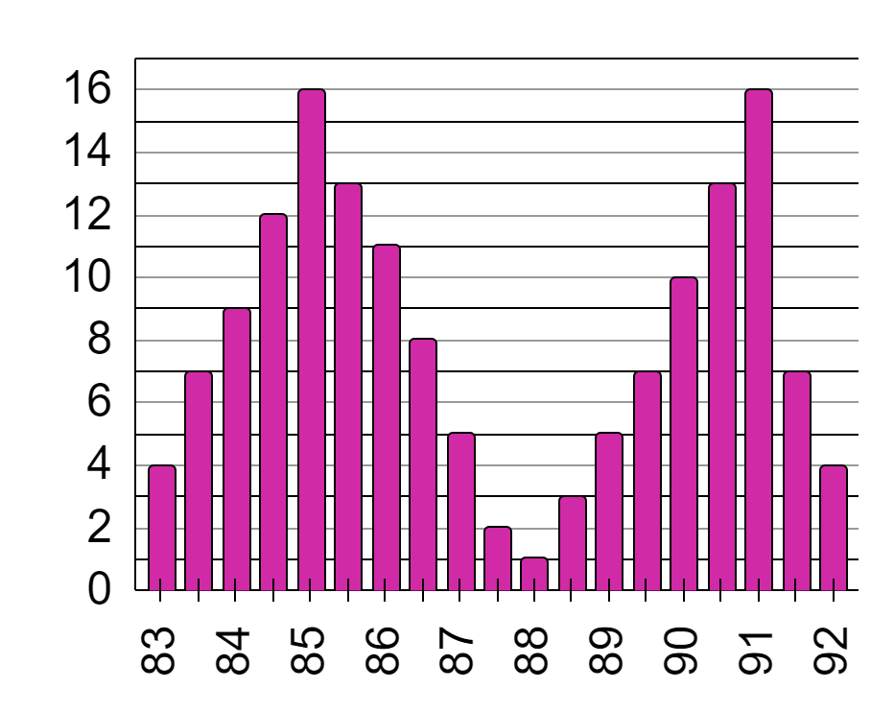

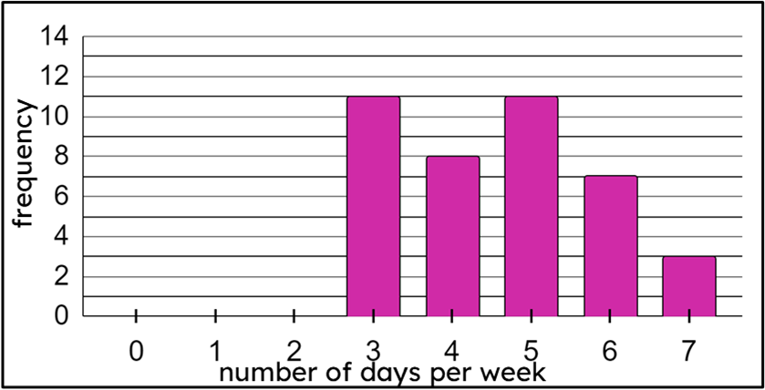
Analysing different statistical representations
a
b
3) Place a ✓ by each letter if all summary statistics given accurately represent the corresponding bar chart.
mean | 87.4
a | b | c | d
c
d
mean | 87.4
range | 9
mode | 85
mean | 87.4
a | b | c | d
range | 9
a | b | c | d
Task B: Completing graphs from summary statistics
1) On Monday, Alex goes to his local town centre and collects data on the number of days per week people visit the town centre.
He loses some of the data he collected, but knows that he asked 58 people, the range is 7 days, and the modal number of days is 2.
a) Which bar does Alex know he must leave blank?
b) How many people are not yet represented on the bar chart?
c) Complete a bar chart that shows this.

Slide 3

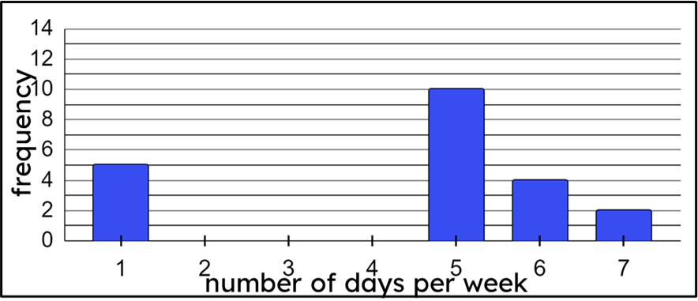

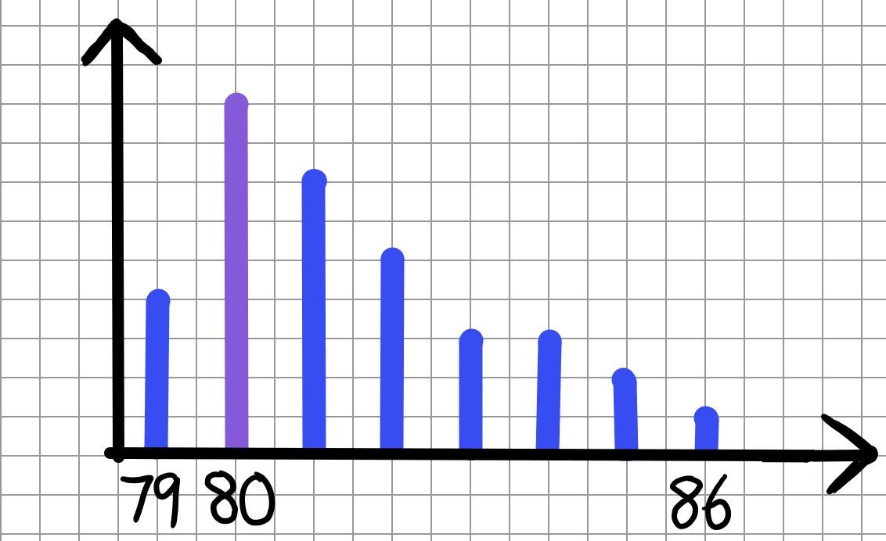
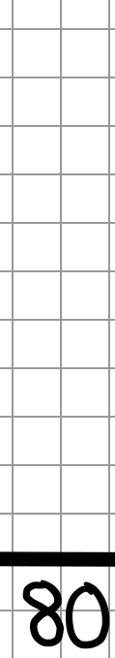
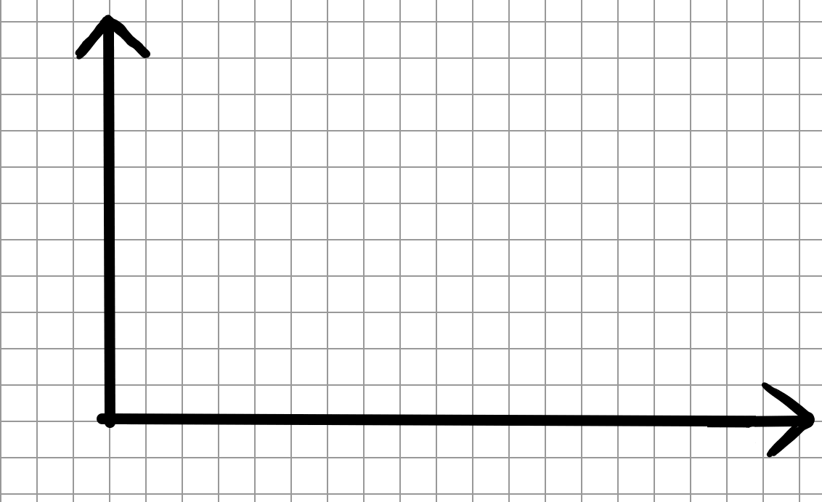
Analysing different statistical representations
2) On Saturday, Jun goes to his local town centre and collects data on the number of days per week people visit the town centre.
He loses some of the data he collected, but knows that he asked 46 people, the data are bimodal, and that more people visit 7 times a week than 2 times a week.
a) How many people are not yet represented on the bar chart?
b) How many people go to town 2 times per week?
c) Complete the bar chart.
Task C: Sketching graphs from summary statistics
1) Jacob wants to sketch a vertical line chart of these summary statistics.
mode | 80
range | 7
a) Write down a calculation to show why the x-axis must be at least 16 squares across.
b) Complete the vertical line graph that Jacob started.
c) Draw a different vertical line graph that also represents the summary statistics Jacob used.

Slide 4
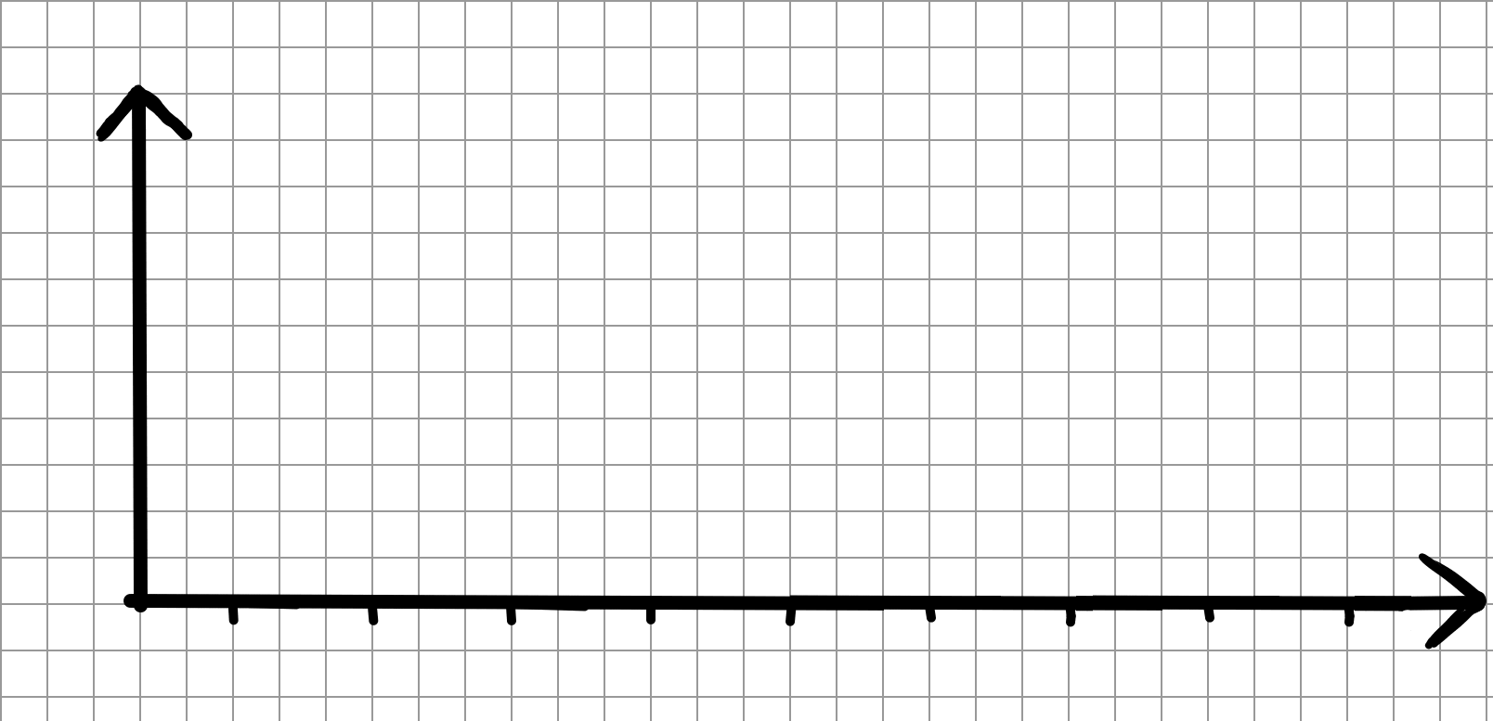
Analysing different statistical representations
2) Sketch two different dot plots that represents the information below.
One of these dot plots must show a bimodal dataset.
median | 14
3) Sketch a bar chart that represents the information below.
The bar chart may not go across the whole x-axis.
mode | bimodal at 4 and 7
range | 5
minimum value | 2
Mathematics in Education and Industry
v2.1

